Slide 1
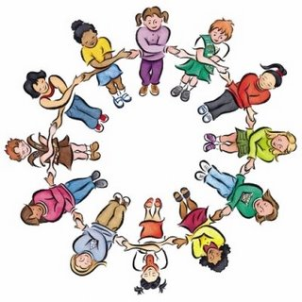
Circle of Friends
Scott I-Patrick
Educational Psychology Service

Slide 2

Circle of Friends
The Circle of Friends approach is a method of supporting individual children by harnessing the power of the peer group.

Slide 3

Circle of Friends ~ misnomer?
The purpose is to elicit understanding in the children and make it more likely that the isolated child will be included and less likely to show behaviours of distress.
It is NOT about the children becoming the child’s friend but making friendly suggestions and being helpful

Slide 4

Psychological Theory
Maslow’s hierarchy of needs
Humanistic psychology
Dodge’s model of social interaction
Social learning theory

Slide 5
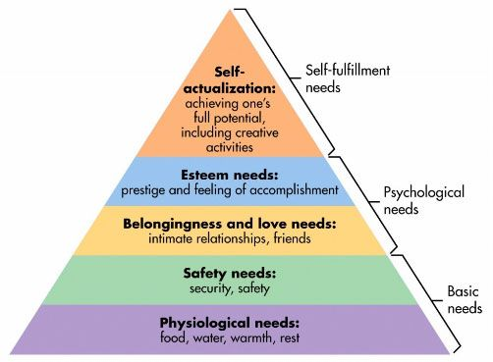
Maslow’s Hierarchy of Needs

Slide 6
Humanistic Psychology
Roger’s (1902–1987) believed that for a person to ‘grow’ they need an environment that provides genuineness (openness and self-disclosure), acceptance (being seen with unconditional positive regard) and empathy (being listened to and understood).

Slide 7

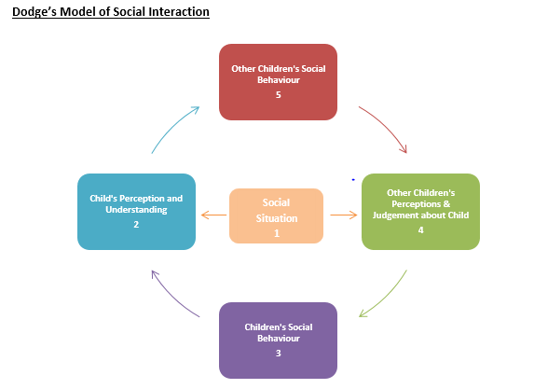
Social Interaction Theory

Slide 8
Social Learning Theory
Social Learning Theory emphasises the importance of environmental influences on learning and behaviour. Going by this, altering the environmental factors would likely have an impact on both learning and behaviour.
CoF harnesses the positive influence of peer which may contribute to improvements in the classroom and playground.

Slide 9

First steps
Cognitive and emotional skills
Old enough to reflect on their own and other children’s behaviours.
Likely to remember the issues discussed and the strategies discussed.
Parents and the child in question understand the process and have given permission.
Ed Psych/SENCo

Slide 10
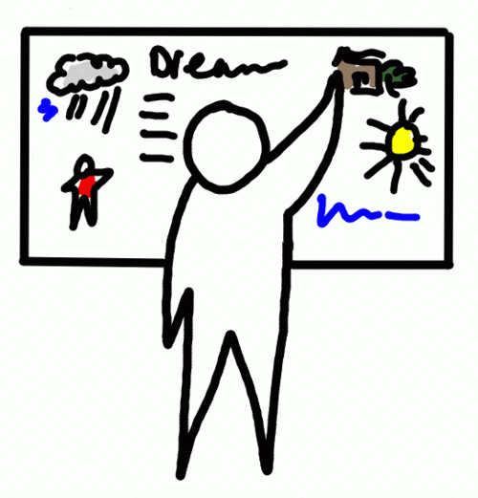

Process
A whole class meeting taken by the EP with the other children but without the target child (about 40 minutes)
Subsequent weekly meetings of a small group, with the target child and with a staff member present to review progress and discuss new strategies (about 15 minutes)

Slide 11

The whole class meeting
This meeting and the subsequent meetings begins and ends with a game for a few minutes.
Three sheets are prepared
~Fred’s strengths
~Fred’s difficulties
~Circles in our lives

Slide 12
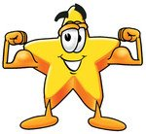
Fred’s strengths
These are elicited from the children and written on a flip chart.
Adults present can prompt the children on suitable responses but they usually have no difficulty in coming up with these e.g. Shares his things, has a good sense of humour, is good at maths

Slide 13

Things that Fred find’s difficult
A second list is compiled, again elicited from the children on things that Fred find’s difficult. These are phrased in a suitable way and put onto a flip chart.
The children are reminded that Fred and his parents have given permission and that we are discussing this to help Fred.
Contributions might include, loses his temper, pushes in the line, took my sweets.

Slide 14
The circles in our lives
Teachers
Child
Minder
Beavers
Lollipop
Lady
Friends
Family
Swim
Club

Slide 15

The psychology bit
It is explained to the children that sometimes, when people are doing things that are hurting other people, it is because they don’t feel so good themselves and they may not feel that they have friends.
It is suggested that maybe some of the things Fred has difficulty with are because he does not feel that he has many friends.
THIS IS THE MOST IMPORTANT PART!
It is important not to rush this part and to create empathy in the class towards the target child.

Slide 16

Eliciting support
The children are asked to think of ways in which Fred could be helped.
They are then invited to be part of a support group which would meet each week for a short time with Fred and a staff member to see if they can think of ways of supporting Fred and each other.

Slide 17
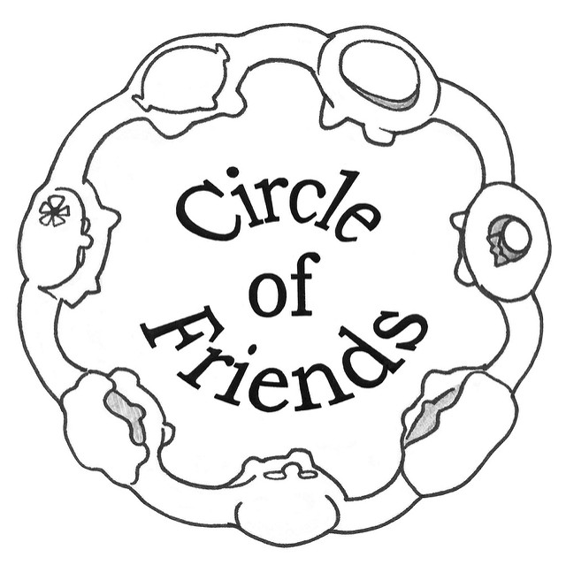
The weekly meeting
Game to begin
Target child asked ‘What has gone well’
Other children invited to contribute
All children asked whether there have been any difficulties
All asked to think of any ideas that might help
Suggestions taken ~ all thanked
Game to end

Slide 18

Safety measures
E D U C A T I O N A L P S Y C H O L O G Y S E R V I C E
Contact with home to ensure that parents are happy with process, and they fully understand what a circle of friends is and that the target child is benefitting throughout
Ensuring that the process has a definite end
Making sure the group are emotionally safe and not taking on too much
Making sure that there is an element of fun.

Slide 19

Evaluating progress
E D U C A T I O N A L P S Y C H O L O G Y S E R V I C E
Comments from the group, child, class teacher and/or child’s parents
Sociograms
Questionnaires

Slide 20

Any questions?

